Slide 1
CMSC 449/691 Malware Analysis
Lecture 13
Following Malware Execution

Slide 2
Following Malware Execution
Control flow graphs in IDA/Ghidra are very useful for analyzing the malware’s possible execution paths
Function calls, loops, if statements, etc.
But execution can change in ways other than jumps and calls
Often need to find out how the malware is executing different areas of code

Slide 3
DLLs

Slide 4
DLL Review
Dynamic Link Library
Exports functions for other executables to use
Advantage: can be shared among running processes, saving memory

Slide 5
How Malware Uses DLLs
By storing malicious code
May export functions to other malware files
May be loaded into another process
By using Windows DLLs
To interact with the operating system via Windows API functions
By using third-party DLLs
To interact with other non-Windows programs
To use a library that may not be on the victim’s machine

Slide 6
Analyzing DLLs
DLLs have many points where code can be executed from
Each exported function
DllMain
DllMain is called whenever a process loads or unloads the DLL
Normally used for managing any resources specific to a process, but malware sometimes uses it for other purposes

Slide 7
Processes

Slide 8
Process Review
Process – program in execution
Used to keep programs from interfering with each other
Have separate address spaces
OS manages how processes access shared resources (CPU, filesystem, hardware, etc.)

Slide 9
Creating a Process
The CreateProcess function is typically used to create a process
Has many parameters, gives caller a high amount of control over how the process is created

Slide 10
Running an Embedded Executable
Malware contains an executable as a resource
Uses FindResource, LoadResource, CreateFile, etc. to write resource to a file
Uses CreateProcess to run this file

Slide 11
Creating a Remote Shell
Remote shell – allows an attacker to run commands on the victim’s computer remotely
Can create a remote shell by opening a socket and using a single call to CreateProcess!

Slide 12
Creating a Remote Shell
Need to pass specific arguments to CreateProcess
The lpStartupInfo parameter points to a STARTUPINFO struct
This struct contains handles to stdin, stdout, and stderr
Point stdin, stdout, and stderr to the socket
Call CreateProcess to run cmd.exe
All input from the malware actor over the socket is run on the command line

Slide 13
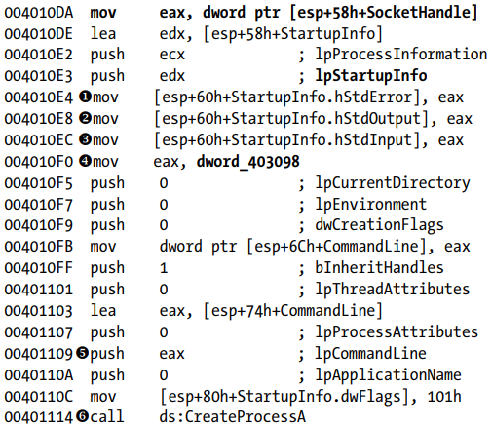
Creating a Remote Shell – Sample Code
Practical Malware Analysis pg 148

Slide 14
Threads

Slide 15
Thread Review
Thread – sequence of instructions belonging to a process that is executed by the CPU
Each process contains one or more threads
All threads share the process’ memory space
Each thread has its own registers and stack

Slide 16
Creating a Thread
Done using the CreateThread function
Takes lpStartAddress, a pointer to a function
Also takes lpParameter, a single parameter to the function
The thread executes the function until it returns

Slide 17
Stealthy DLL Loading
Can use CreateThread to covertly load a library into a process
Need to set certain parameters to CreateThread
Pass the address of the LoadLibrary Windows API function as the lpStartAddress parameter
Pass the name of the desired library as lpParameter
Even more stealthy if “LoadLibrary” and the name of the library are obfuscated

Slide 18
Services

Slide 19
Services Review
Service – a task that runs in the background without an associated process or thread
Managed by the Windows service manager

Slide 20
Why Malware Uses Services
Can be set to automatically run when the computer boots
Gives persistence
Often run with SYSTEM privileges
But need admin to specify this

Slide 21
Creating / Starting a Service
OpenSCManager – Returns a handle to the service control manager, which is needed for all other service-related API calls
CreateService – Adds a new service to the service control manager
Can specify that the service automatically runs at boot
StartService – Starts a service manually

